Slide 1
SMART Home
Group 2:
John Satterla – Computer Engineer – Wireless Connectivity
Zachary Eakerns – Electrical Engineer – Biomedical Station
Zarka McClung (Team Lead) – Computer Engineer – Facial Recognition
Christian Jensen – Electrical Engineer – Voice Recognition

Slide 2
Project Description
Our system will monitor a patient's position, and the environment around them will react to their movements. A station will be located in the home to monitor the user’s vitals including EKG, oxygen in their blood, and their heart rate. The “room” will have 2 major appliances that are activated via facial or voice recognition. Lights and other items will turn on as the user moves throughout the “room”. There will be a door that is automatically opened when the user is trying to enter the room.

Slide 3










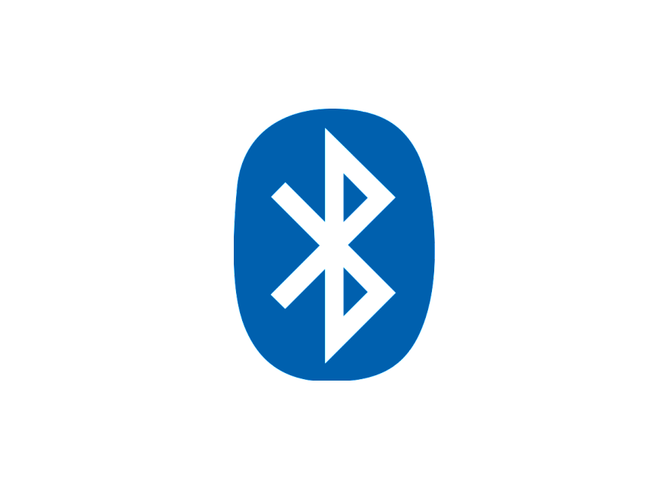

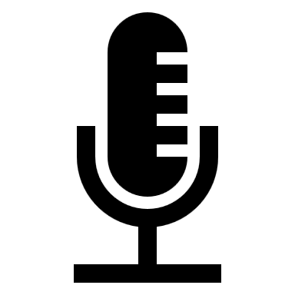
System Overview
Door can be opened automatically via facial recognition or control from central processing station via Zigbee
LEDs to represent Lights
LCD screen represents TV
Biomedical station gets EKG, heart rate, and blood oxygenation of the user, relays information to the Central processing station. Zigbee module takes commands from central processing station to control devices
Biomedical Station
Full size automatic door with facial recognition
Servo based washer representation
Small Scale House Model
Computer fan to represent ceiling fan
Portable BLE Time of Flight device reacts to movements of user throughout the room and devices turn on inside the small scale model
Portable Location Detection Device
Central processing station (computer) displays system information and can control devices via voice commands. Communicates with rest of devices via Zigbee
Bluetooth ToF Beacon
Zigbee Module
Central processing Station, with Voice Recognition
Microcontroller
John Satterla
Notes:
Need to edit this slide to include the separate systems

Slide 4
Controlling Devices Wirelessly with Zigbee
Zigbee is a Wireless, low power mesh networking protocol designed for home and building automation
It supports low data rates (250kbps) and works on top of the defined IEEE 802.15.4 physical layer [16]
The protocol was standardized in 2003 and is maintained by the Zigbee Alliance
Zigbee is probably in most of your homes today, with smart hubs like the Amazon Alexa or Google’s Nest able to connect all devices together
John Satterla

Slide 5
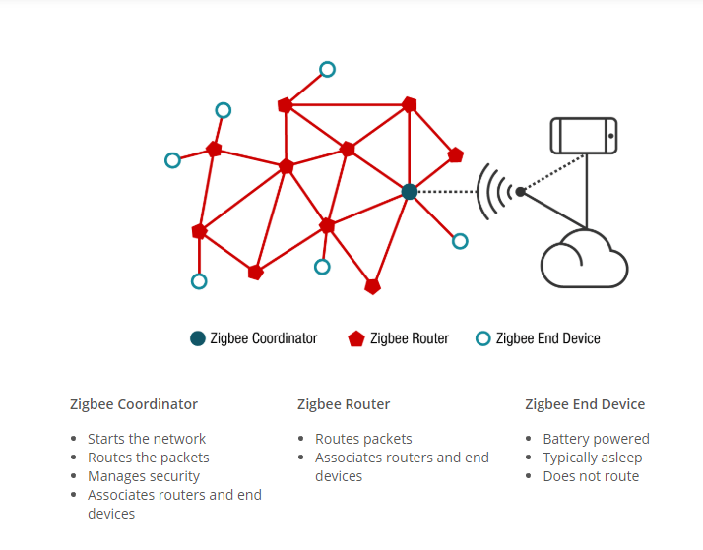
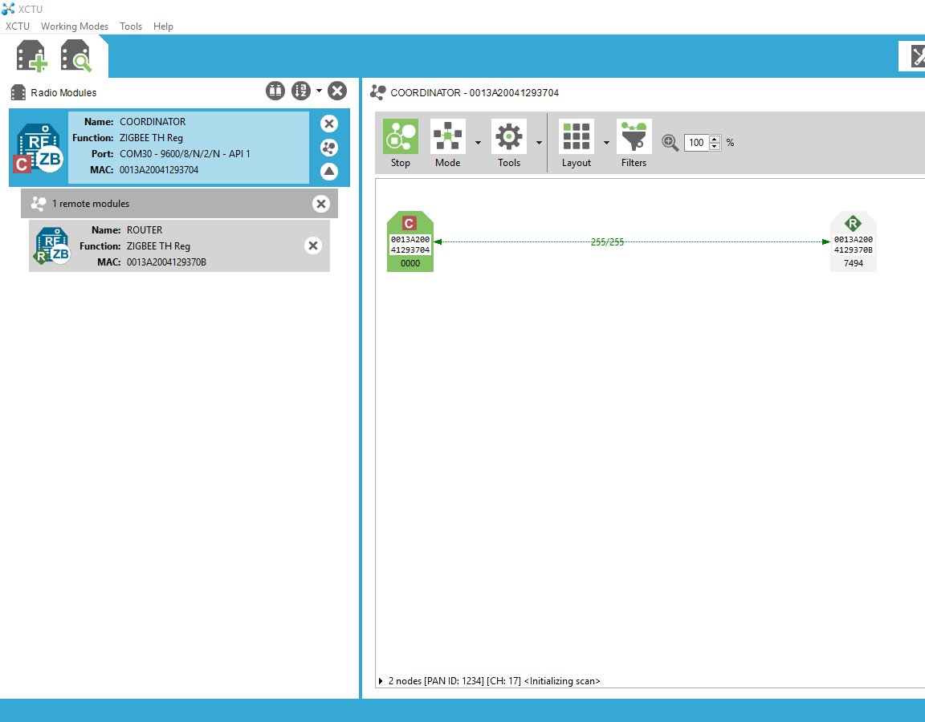
Controlling Devices Wirelessly with Zigbee
[11]
John Satterla

Slide 6
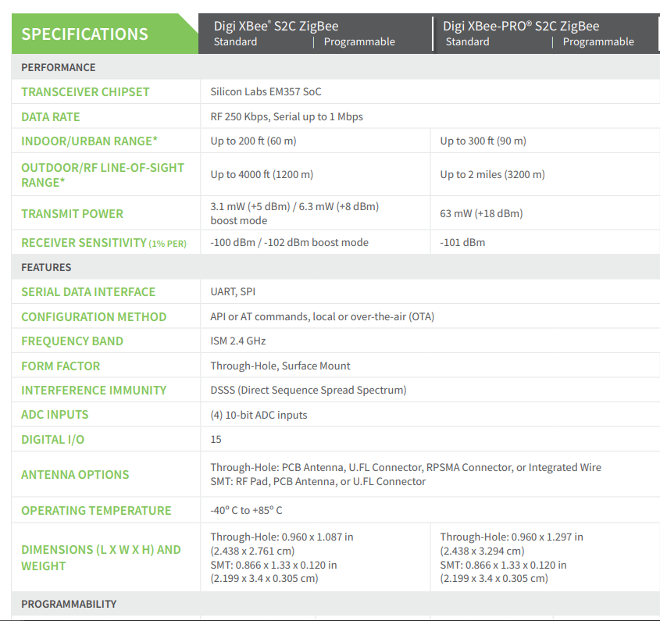
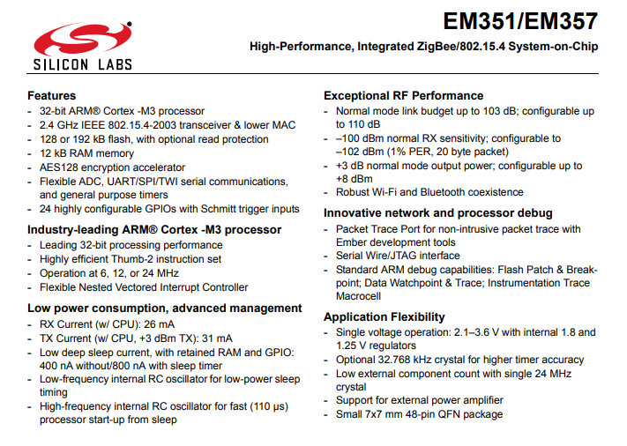
Controlling Devices Wirelessly with Zigbee
For our purposes, we will use Wireless microcontrollers that are integrated into Digi’s “Xbee” modules
[1]
[2]
John Satterla

Slide 7
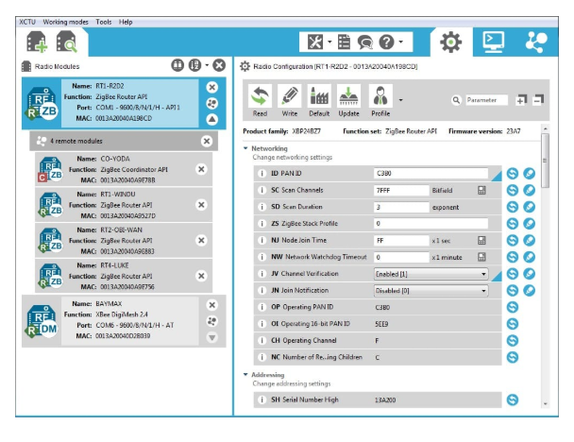
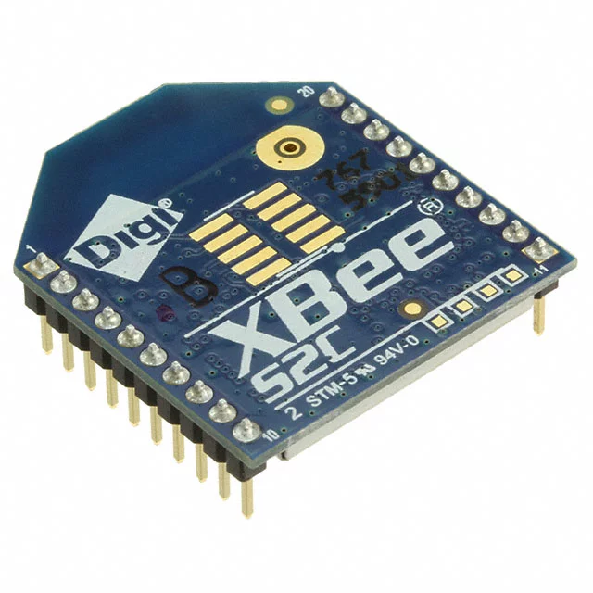
Controlling Devices Wirelessly with Zigbee
Using these so that we do not have to do any RF layout with wireless MCUs/ time constraints
Can communicate and be programmed separately for wireless purposes to form network with IDE, and then communicate back to main MCU via SPI or UART
[3]
John Satterla
Notes:
...

Slide 8
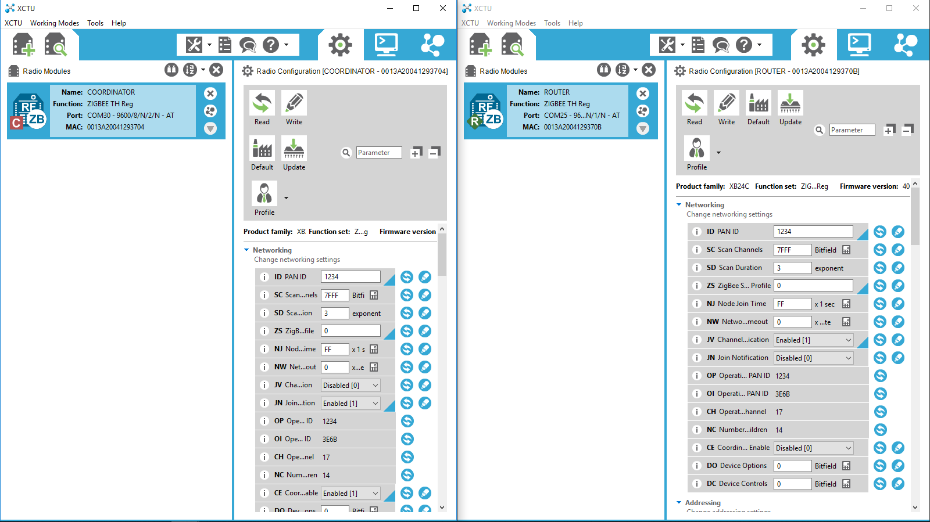
Controlling Devices Wirelessly with Zigbee
PAN ID = Personal Area Network ID
[3]
John Satterla
Notes:
...

Slide 9
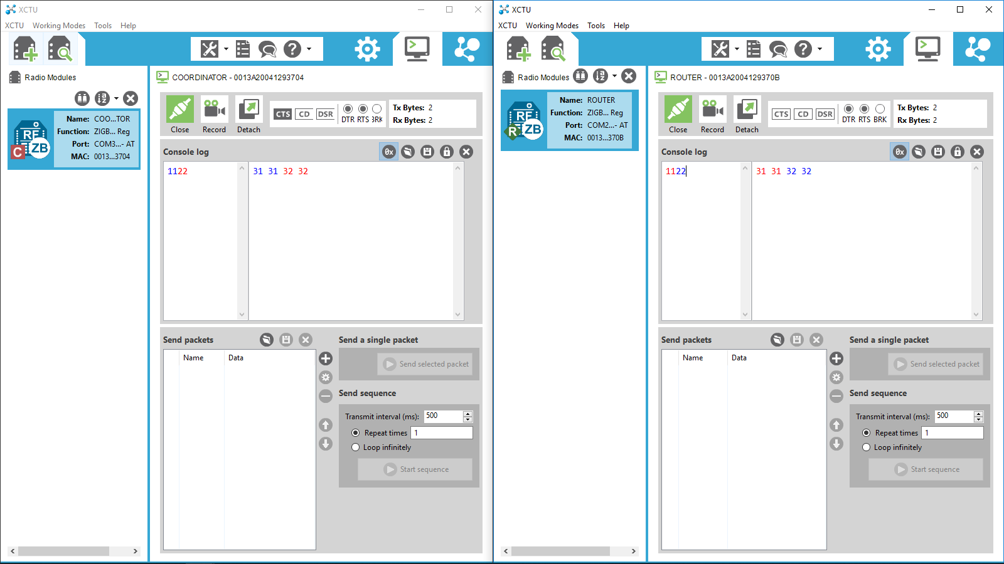
Controlling Devices Wirelessly with Zigbee
Device Communication testing via Command Line GUI
John Satterla
Notes:
...

Slide 10
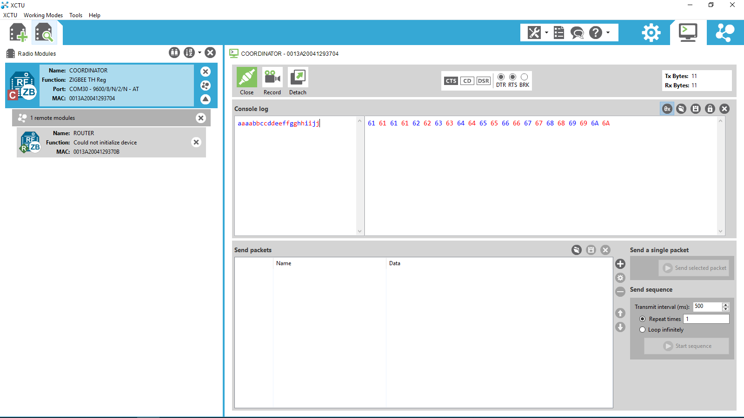
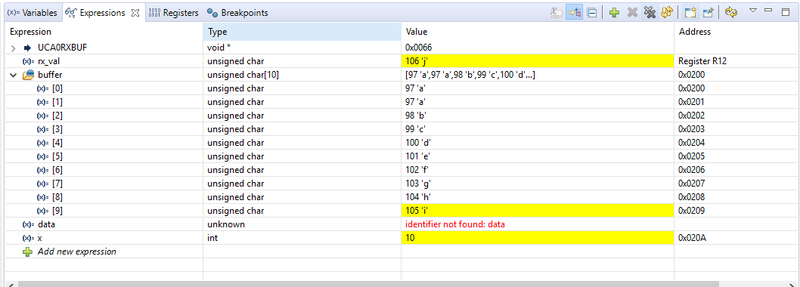
Controlling Devices Wirelessly with Zigbee
MSP430 Test filling up array with received characters
Coordinator Sending and receiving bytes from Router w/ MSP430
John Satterla
Notes:
...

Slide 11
Tracking Location of the Patient Monitor
Ideally work indoors, so using GPS not preferred because of accuracy and not able to get fix inside of buildings
BLE ToF – Bluetooth Time of Flight
Time of Flight is used to estimate range by measuring the round trip delay of an RF packet exchange
At least two devices needed, and operate generally as a master and a slave, where the master calculates average round trip delay for hundreds of packets to be as accurate as possible (try to reduce error from interference, other RF related differences) [ref]
John Satterla

Slide 12
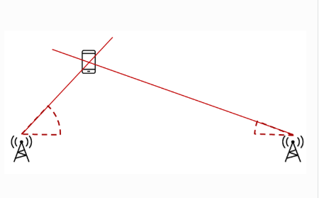
Tracking Location of the Patient Monitor
For this, Texas Instruments has a experiential stack that I am going to evaluate and see what kind of performance I can get
The tricky part will be using two masters that are positioned at two known points, and then connecting to the single slave on the patient to triangulate it’s position
Patient monitor
Master 2
Master 1
[1]
John Satterla
Notes:
Show initial testing results with bluetootqh

Slide 13
Tracking Location of the Patient Monitor
Hardware on order:
TI CC2640R2F Launchpads
Why an SoC? Ability to quickly sample the data coming from the slave and calculate the distance via ToF
Specs:
CPU: ARM Core M3 @ 48 MHz
Memory: 128kB flash, 28kB RAM
Radio: 2.4GHz with Certified Bluetooth 5, 4.2 support, 102 dB link budget for BLE
Peripherals: I2C, ISS, UART, TRNG, AES-128
Low power features: RX at 0dBm – 5.9 mA, TX at +5dBm – 9.1 mA, as low as 1.1uA standby
General: 3.3V operation
John Satterla
Notes:
Pictures, testing

Slide 14

Biomedical Station
A station will be installed in the home that the patient can use to monitor their electrocardiogram (EKG), heart rate, and blood oxygenation.
EKG signals will be monitored using two electrodes placed on the chest as shown in the image. This information will also give heart rate.
Pulse oxygenation will be found by using a pulse oximeter that will attach to the patient's finger.

Slide 15
Electrocardiograph
Anywhere from a 100 µV to 2 mV of voltage can be detected across the skin of a person due to heart muscles depolarizing.
This signal must be amplified by at least 500, however since the input is so small noise must be filtered out.
The primary source of noise is 60 Hz transmission lines. Due to this a notch filter will be used in addition to low pass.

Slide 16
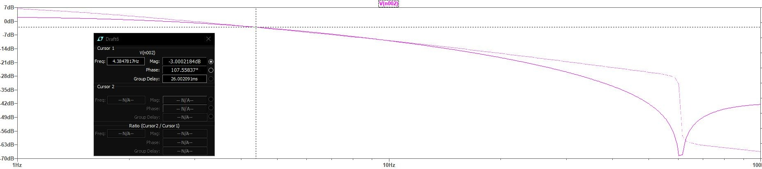
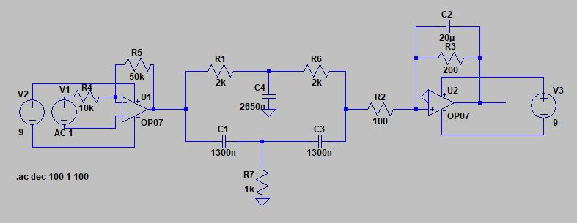

Slide 19
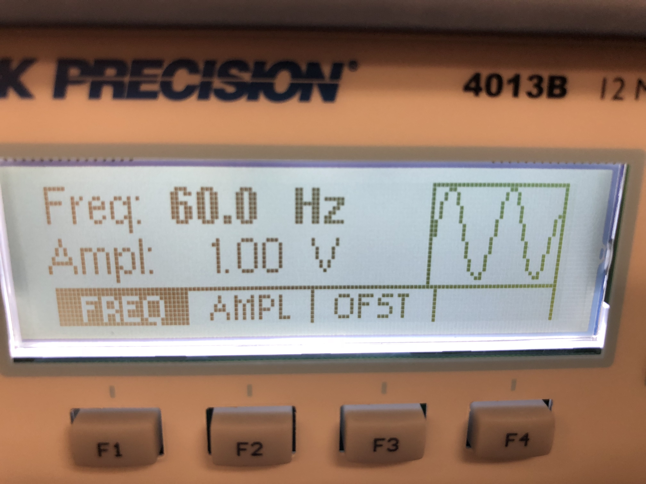
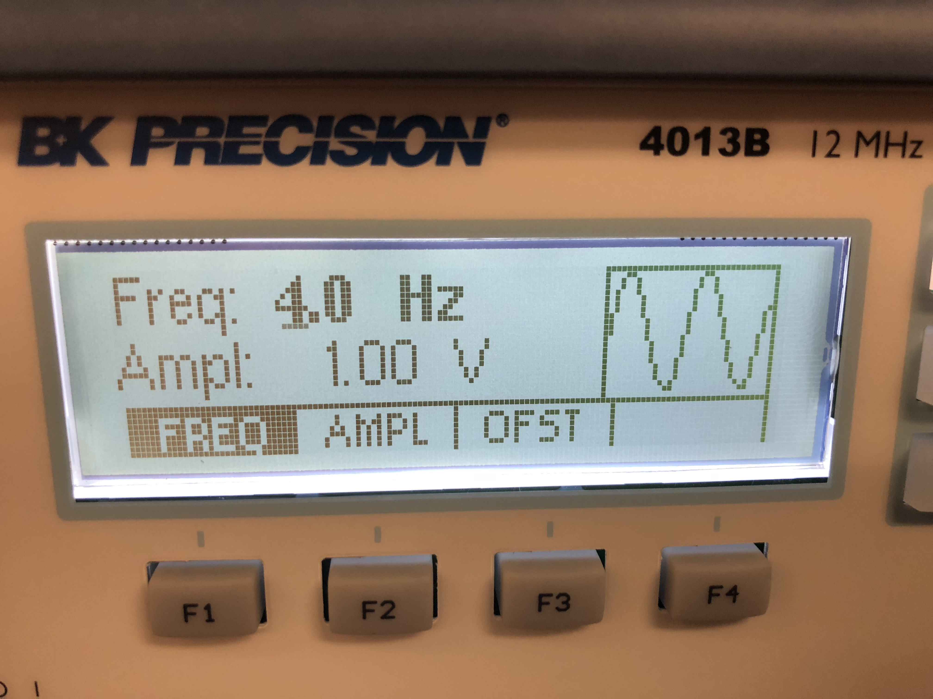
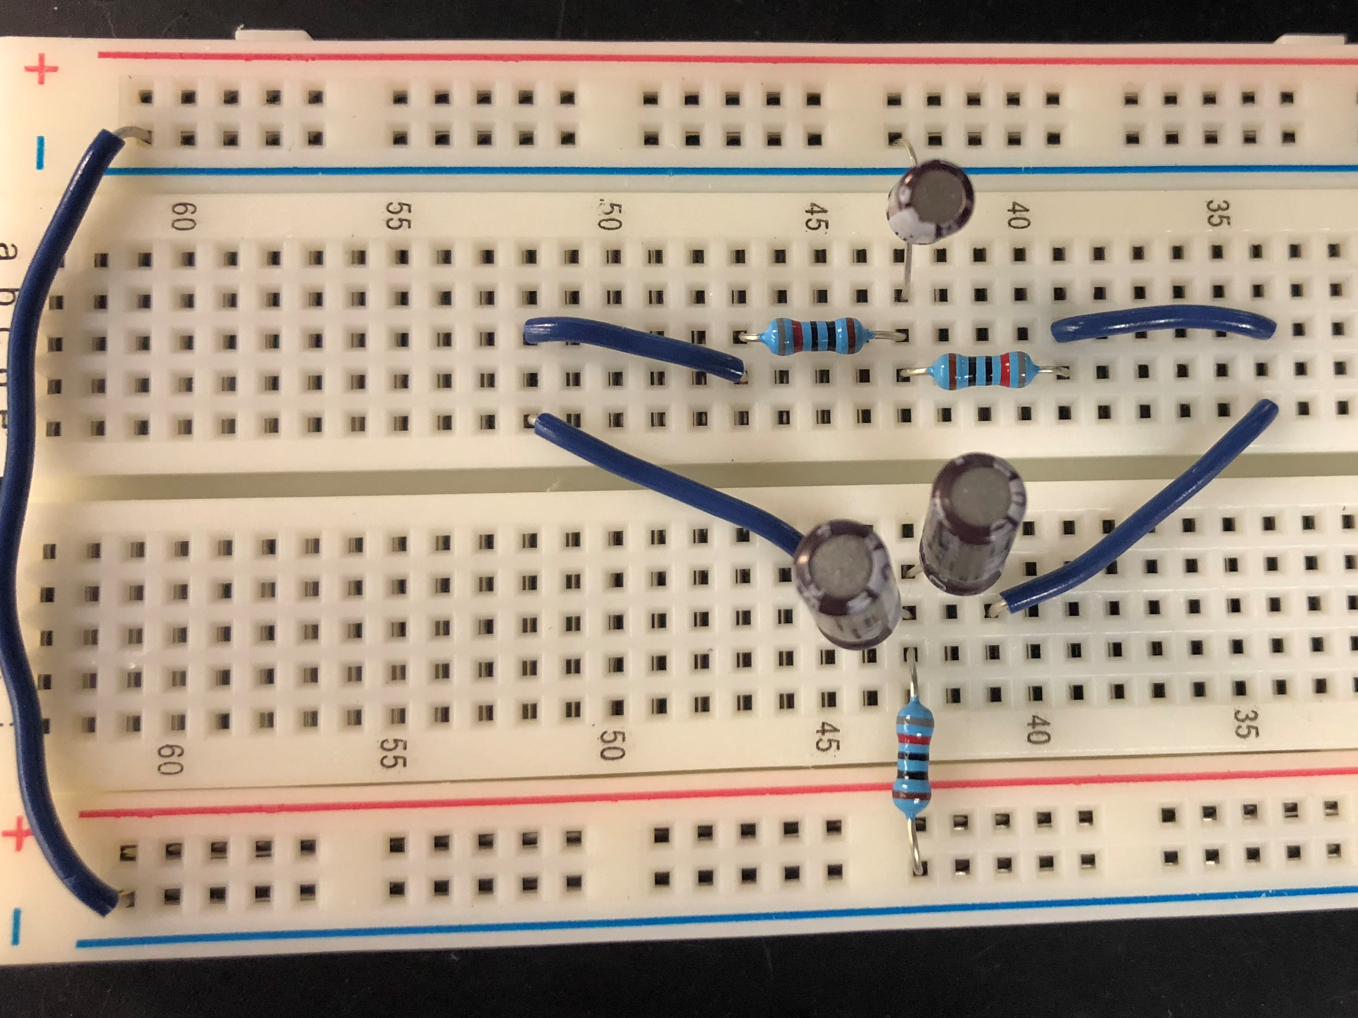
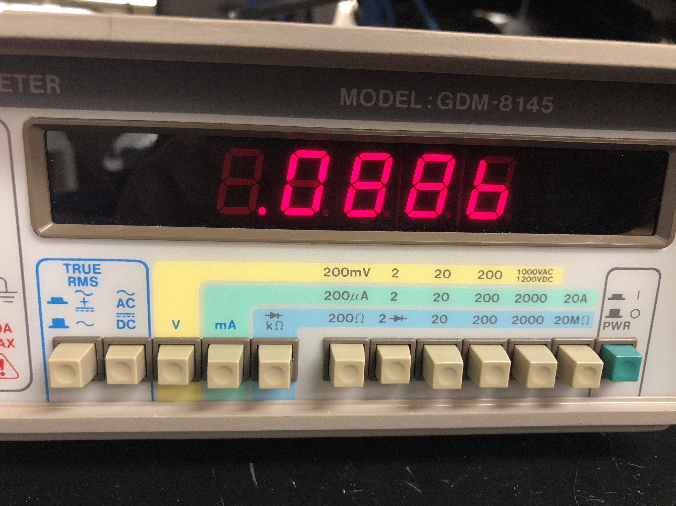
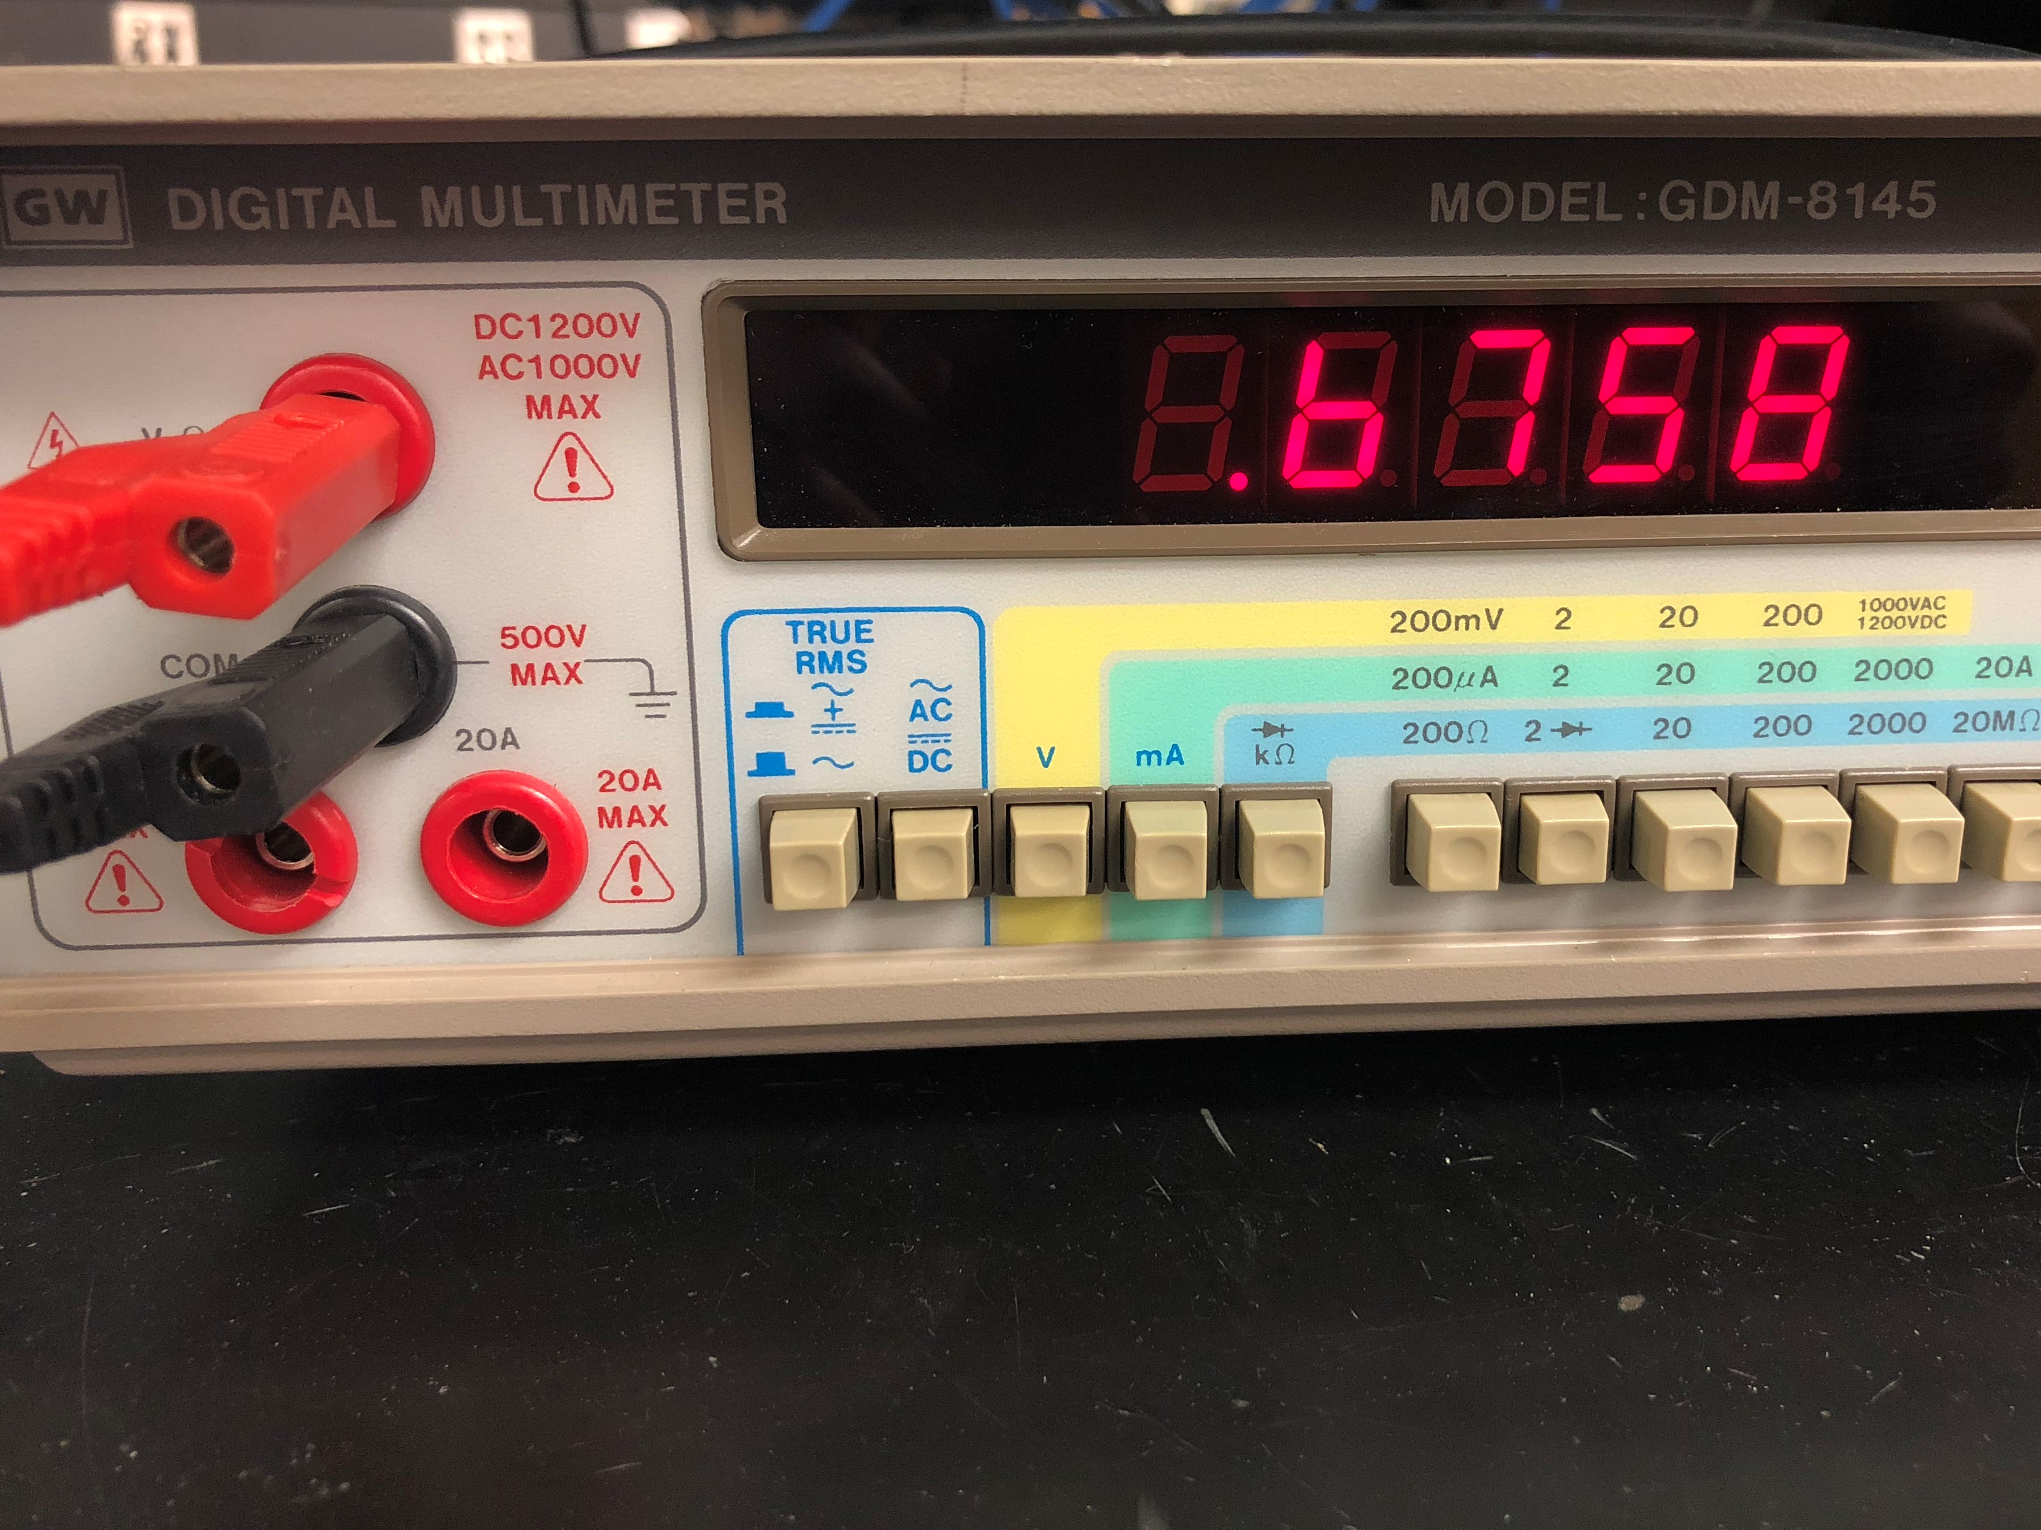

Slide 20
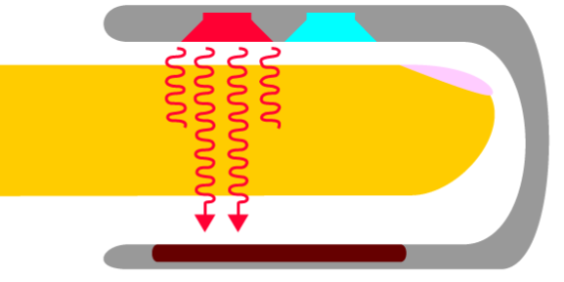
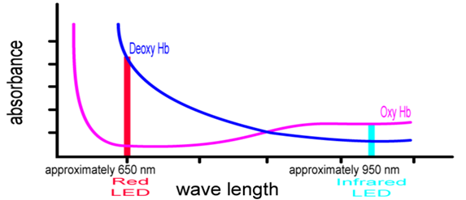
Measuring Blood Oxygenation
By shining a red light and an infrared light through an area on a patient containing an artery, the Sp02 level can be found by comparing the ratio of red light absorbed to infrared light absorbed.
Oxyhemoglobin absorbs more infrared light, while deoxyhemoglobin absorbs more red light.
[5]
[5]

Slide 21
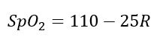
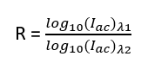
Pulse Oximetry Calculations
As mentioned, the oxygenation of a person's blood is found by using the ratio of light absorbed.
Found using the equation
Where

Slide 22
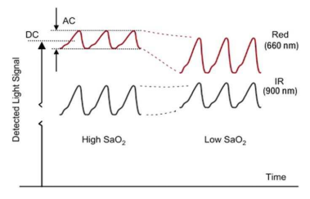
[5]

Slide 23
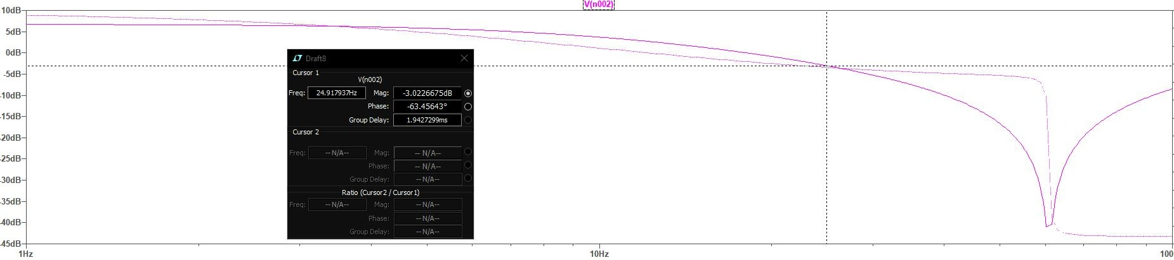
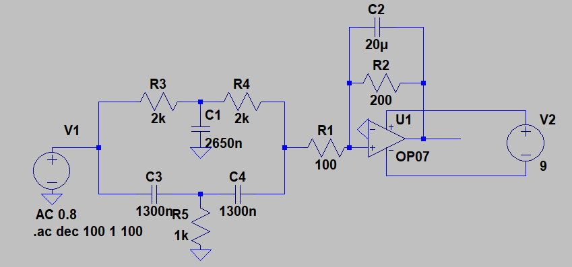

Slide 24
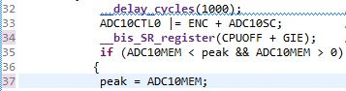
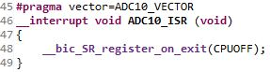
Software
Peak detection and accurate readings from an ADC are the main tasks of the biomedical station's program.
An MSP430G2553 will be used in order to conserve on both the projects budget and power consumption.
The G2553 has a 10-bit ADC which with the low voltage of the project will be sensitive up to 0.1 mV.

Slide 25
Moving Forward
Amplifiers must be acquired and tested before being integrated with filters.
Code will continue to be written. For EKG the values from the ADC must be graphed in real-time, while an algorithm needs to be written to control the LED's and calculate pulse oxygenation.
Once these are finished the two will be integrated allowing a laptop to display the patient's vitals.

Slide 26
Voice Recognition Methods
Process:
Ask user to set up phrases before
Type name of phrase
Speak the phrase (3x times)
Find the PSD of the signal
Set peaks as template
Speech recognition
Poll for incoming phrases
Sample input
Find the PSD of the signal
Compare peaks with Template
Matlab [7]
Using the computer and its microphone to detect voice
Allows for easier integration with the entire project
Using the Voicebox Toolbox [9]
Contains many voice and audio related functions
*The system will be speaker dependent
(Only recognizing one specific person's commands)

Slide 27
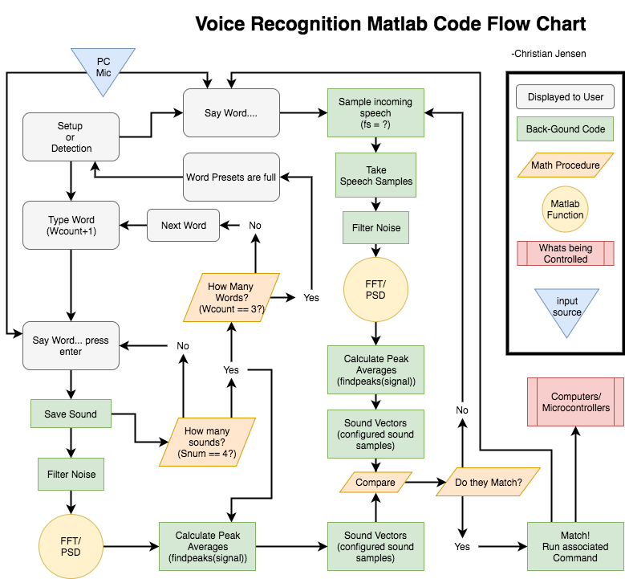

Slide 28
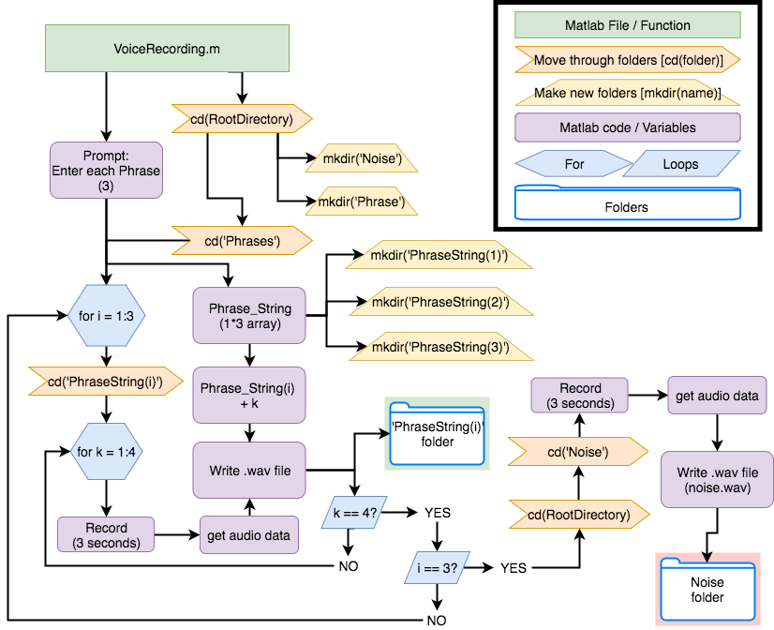
VoiceRecording.m

Slide 29
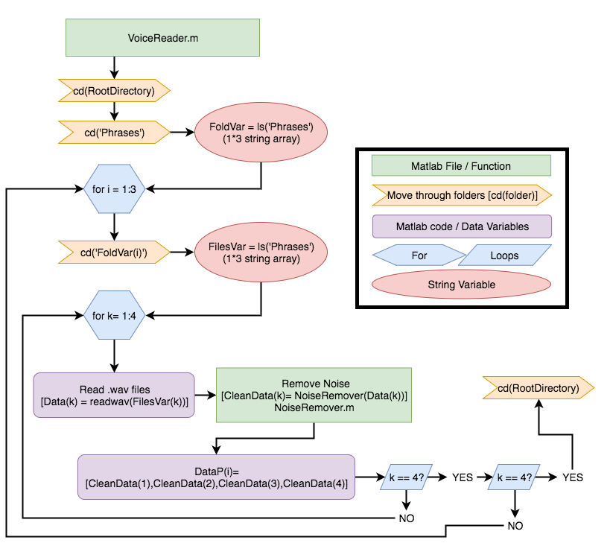
VoiceReader.m

Slide 30
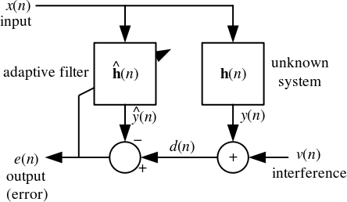
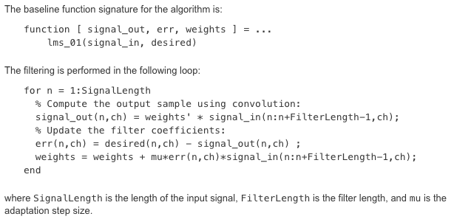
Voice Recognition – Noise Filtering
Least Mean Squared adaptive filter
Objective:
Isolate users' speech from background noise
Method:
Adaptive filter[13]
Requires noise data – noise.wav
Still working through example code*

Slide 31
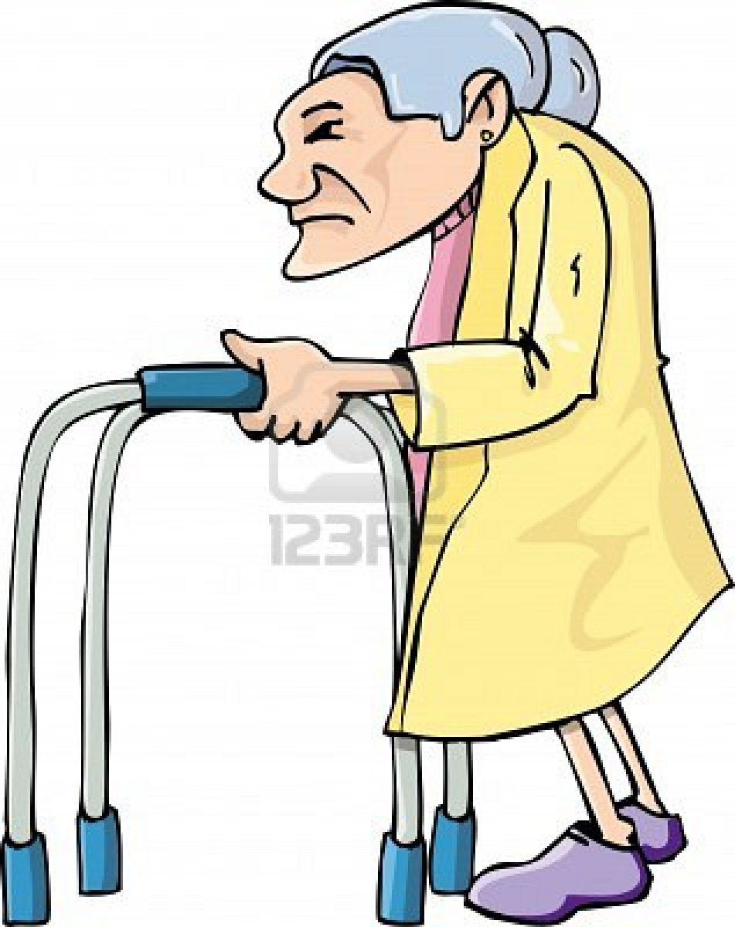
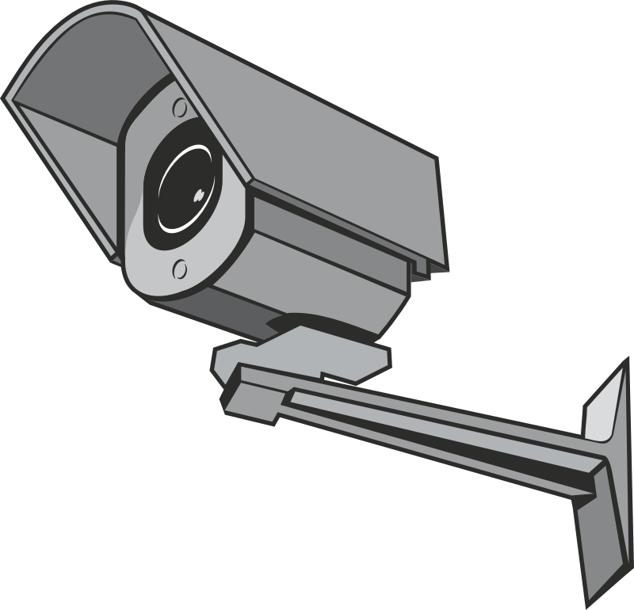
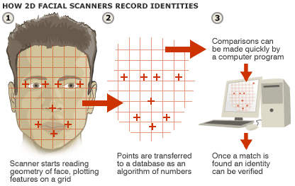
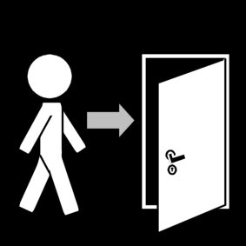
Face Recognition Using OpenCV v3.4 and Python v2.7
Goal: Detect recognized user’s face to open a door automatically.
This Photo by Unknown Author is licensed under CC BY-ND
This Photo by Unknown Author is licensed under CC BY-NC
This Photo by Unknown Author is licensed under CC BY-ND

Slide 32
Face Recognition Using OpenCV v3.4 and Python v2.7
Why use OpenCV computer vision library?
Free-to-use open source computer vision and machine learning software library (BSD license - minimal to no restrictions on the use of the library)
Can employ the code and tweak it as we want by adding copyright notice
Can access more than 2,500 algorithms using the library
Guided tutorials and documentation available

Slide 33
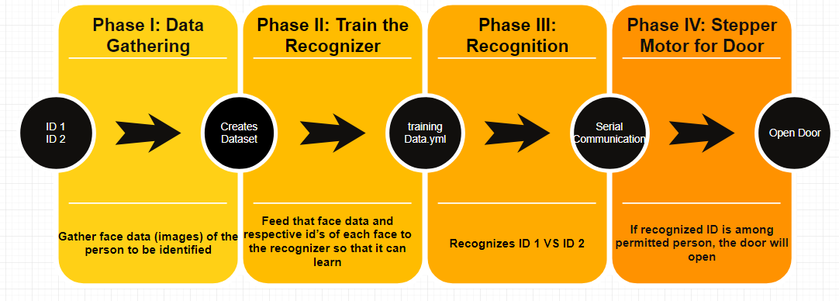
Phases of Face Recognition and Automatic Door

Slide 34
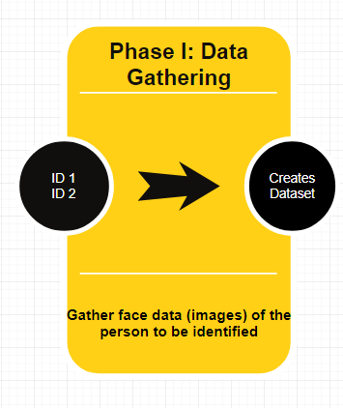
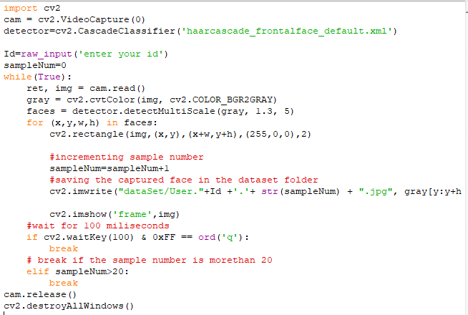
Turning on webcam
Using Frontal face harcascade classifier
getting ID number
Collecting 21 samples and getting out of the loop
[3]
[11]

Slide 35
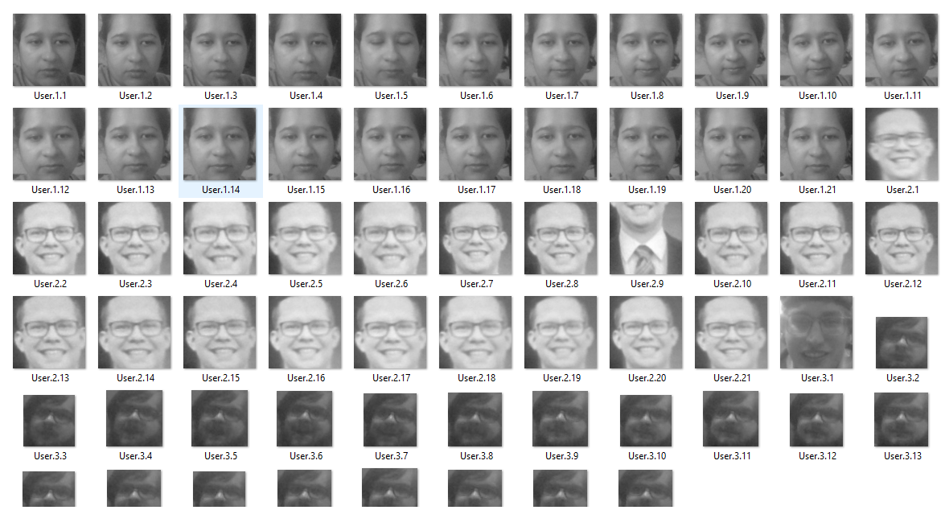

Slide 36
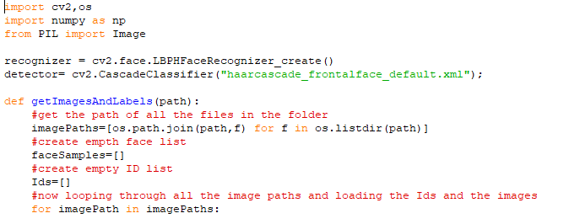
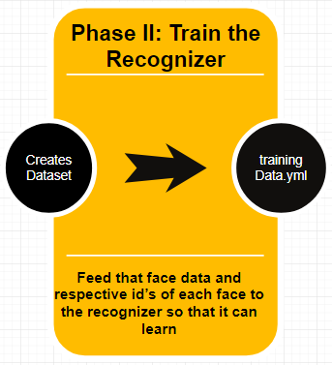
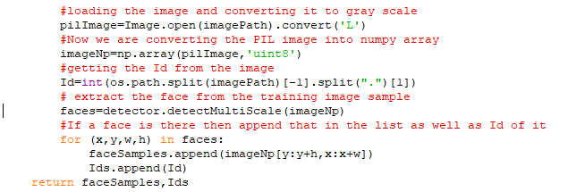
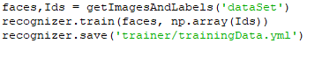
Recognizer = LBPH (LOCAL BINARY PATTERNS HISTOGRAMS) Face Recognizer, included with OpenCV package
Join root path with image name to create list of all images
Converting PIL (python image library) images to gray scale & numpy array format
Converting integer array to numpy array for Ids

Slide 37
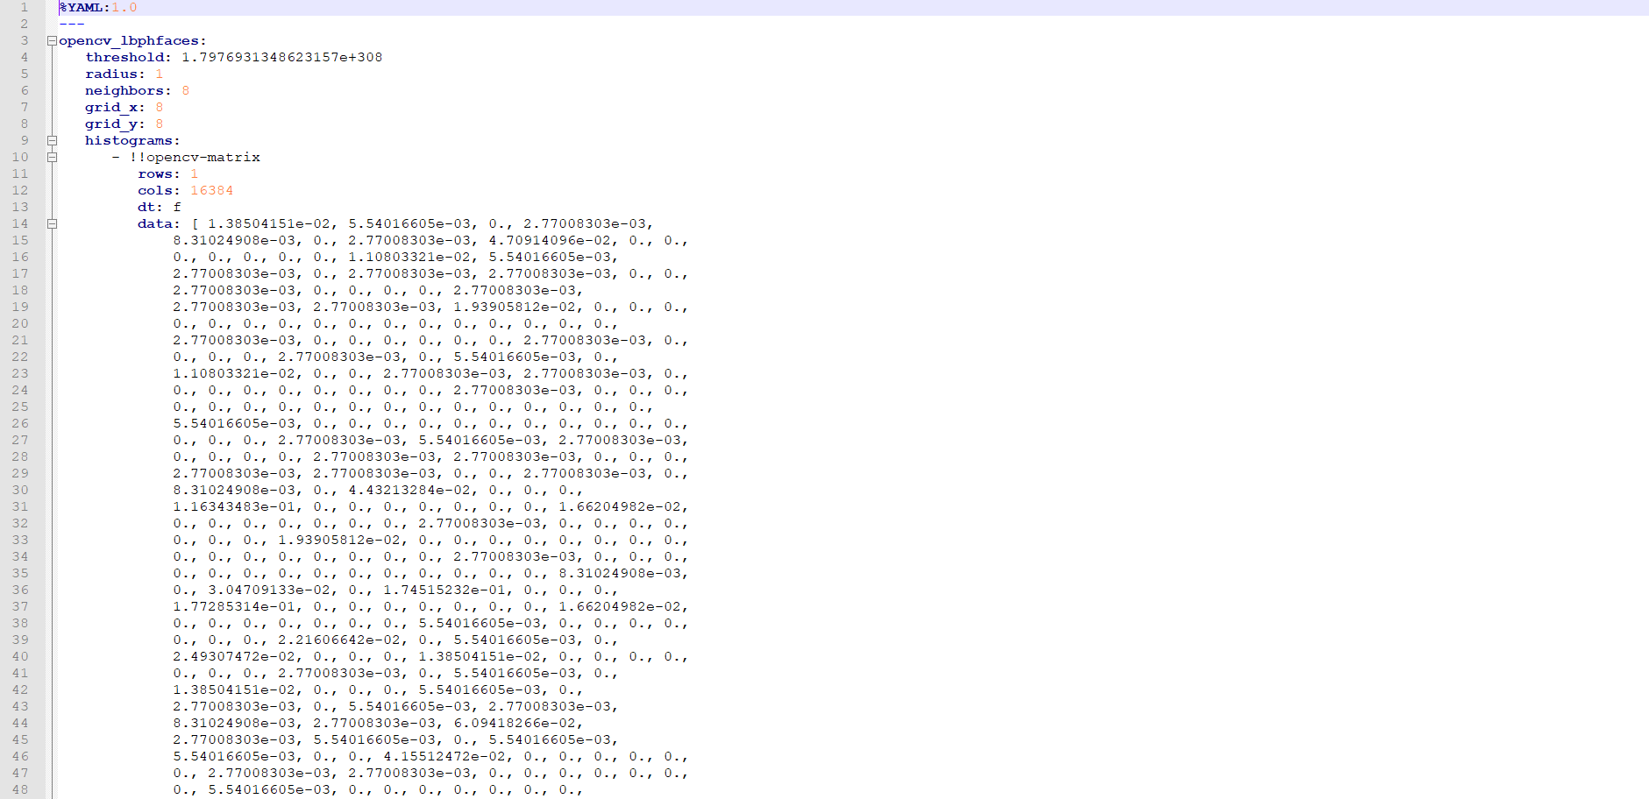
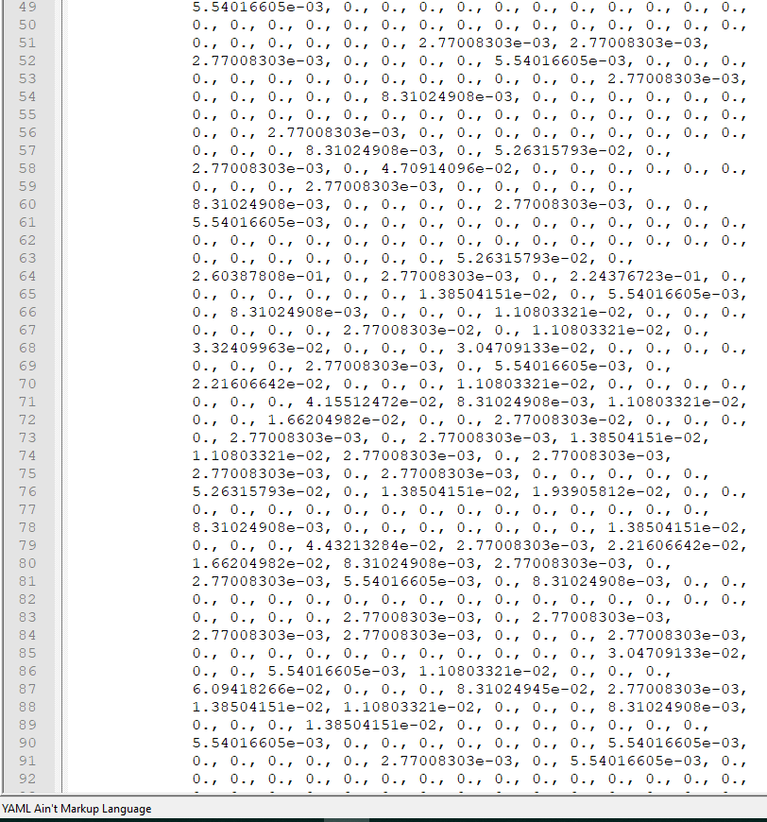
Provides a complete histogram and now we have trained the software using our userIDs

Slide 38
Plan for Phase III and IV
Phase III:
Code Recognizer
Use the .yml file generated to detect ID1 vs ID2
Use recognizer.predict to predict the userID and also display the confidence of prediction
Also display Unknown for unauthorized users
Phase IV:
Use prediction to send serial communication to a microprocessor
Turn on a stepper motor if the user is authenticated.
Inform main system which userID left/ entered the house.

Slide 39
Power Budget
Part Name | Quantity | Supply Voltage (V) | Supply Current (mA) | Power Subtotal (W)
Lenovo E545 laptop | 1 | 20 | 3250 | 65
MSI GT72VR Laptop | 1 | 19.5 | 11800 | 230
MSP430G2553 | 2 | 2.2 | 0.23 | 1 m
LM324 | 2 | 5 | 1 | 10 m
AD624 | 1 | 9 | 5 | 45 m
LED | 2 | 2 | 18 | 36 m
Phototransistor | 1 | 0.8 | 2 | 1.6 m

Slide 40
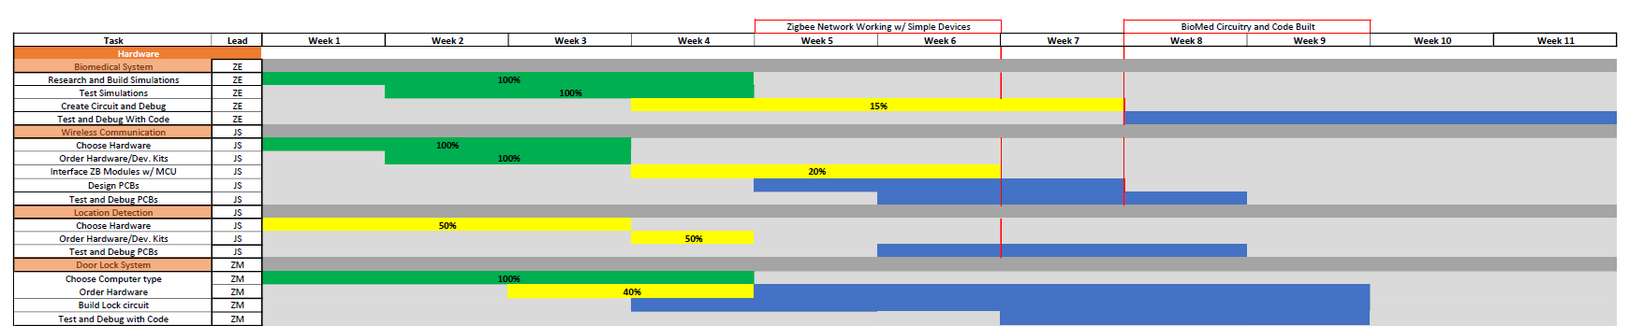
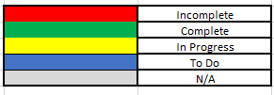

Gantt Chart

Slide 41

Gantt Chart

Slide 42

Budget

Slide 43

Material Cost

Slide 44
References
“DIGI XBEE® AND DIGI XBEE-PRO® ZIGBEE,” digi.com, 2018. [Online]. Available: https://www.digi.com/pdf/ds_xbee_zigbee.pdf. [Accessed: 25-Sep-2018].
“EM351/EM357 High-Performance, Integrated ZigBee/802.15.4 System-on-Chip,” silabs.com, 2013. [Online]. Available: https://www.silabs.com/documents/public/data-sheets/EM35x.pdf. [Accessed: 25-Sep-2018].
“Face Recognition Using OpenCV,” The Codacus, 23-Jun-2017. [Online]. Available: https://thecodacus.com/face-recognition-loading-recognizer/#.W72PXGhKjIU. [Accessed: 10-Oct-2018].
“Filter Audio Signal Using MATLAB Code,” Reconstructing an Image from Projection Data - MATLAB & Simulink Example. [Online]. Available: https://www.mathworks.com/help/simulink/ug/tutorial-integrating-matlab-code-with-a-simulink-model-for-filtering-an-audio-signal.html#bsdakyu-3. [Accessed: 10-Oct-2018].]:
“How pulse oximeters work explained simply.,” How Equipment Works. [Online]. Available: https://www.howequipmentworks.com/pulse_oximeter/. [Accessed: 18-Sep-2018].
How to Design Peripheral Oxygen Saturation (SpO2) and Optical Heart Rate Monitoring (OHRM) Systems Using the AFE4403, 3AD. [Online]. Available: http://www.ti.com/lit/an/slaa655/slaa655.pdf. [Accessed: 20-Sep-2018].
“Least mean squares filter,” Wikipedia, 16-Aug-2018. [Online]. Available: https://en.wikipedia.org/wiki/Least_mean_squares_filter. [Accessed: 10-Oct-2018].
M. Brooks, “VOICEBOX: Speech Processing Toolbox for MATLAB,” Description of fxpefac. [Online]. Available: http://www.ee.ic.ac.uk/hp/staff/dmb/voicebox/voicebox.html#sigproc. [Accessed: 10-Oct-2018].]
“OpenCV library,” About - OpenCV library. [Online]. Available: https://opencv.org/. [Accessed: 10-Oct-2018].
“OpenCV Reviews: Overview, Pricing and Features,” Financesonline.com. [Online]. Available: https://reviews.financesonline.com/p/opencv/. [Accessed: 10-Oct-2018].
“OpenCV: Core functionality,” Cascade Classification - OpenCV 2.4.13.7 documentation. [Online]. Available: https://docs.opencv.org/3.4/d0/de1/group__core.html#ga0f9314ea6e35f99bb23f29567fc16e11. [Accessed: 10-Oct-2018].
“Zigbee | Overview | Wireless Connectivity,” SimpleLinkTM Zigbee Wireless MCUs, 2018. [Online]. Available: http://www.ti.com/wireless-connectivity/simplelink-solutions/zigbee/overview.html. [Accessed: 26-Sep-2018].

Slide 45
Questions?

